Slide 1

Exploratory Data Analysis (EDA) of AMCAT Dataset

Slide 2
About me
Myself Soubhik Ghosh , I am an UG student pursuing a B.Tech course in Civil Engineering at National Institute of Technology Agartala.
Data Science offers the unique ability to extract meaningful insights from complex data, which is essential in today's data-driven world. I want to learn Data Science to develop analytical skills that allow me to solve real-world problems, uncover patterns, and make data-informed decisions. By mastering tools like Python and Machine Learning Algorithms, I aim to contribute to impactful projects that drive innovation and efficiency.
Summer Intern at Agartala Smart City Ltd. (ASCL) & Virtual Intern at Hex Softwares.
Connect with Me :
LinkedIn : https://www.linkedin.com/in/soubhik-ghosh-2b4245259/
Github : https://github.com/King-Soubhik

Slide 3
Dataset Description :
In any Exploratory Data Analysis (EDA) project, the first step is to gain a thorough understanding of the dataset, its structure, and the kind of information it contains. Below is a detailed data description based on the typical format of a dataset that includes salaries as the target variable, and other attributes such as designation, degree, gender, and specialization. The specific details might vary depending on the actual dataset, but here's a general breakdown.
Designation : The job position of an individual. (e.g., Software Engineer, Hardware Engineer, Data Scientist etc.)
Degree : The highest level of education achieved by an individual. (e.g., B.Tech, M.Tech, PhD etc.)
Gender : Represents the gender of the individual. (e.g., Male, Female)
Specialization : The individuals studied or the field in which they work. (e.g., Computer Science, Electronics etc.)
Salary : The annual salary or wage that the individuals are earning in their current jobs. This will be the target variable in this EDA project.
DOB : The date of birth of an individual.
JobCity : The geographical region or location where the individual is employed. (Bangalore, Chennai, Noida etc.)
DOJ : The date on which the individuals joined or starts working for an Organization.
10 percentage : The percentage obtained by an individual in Class 10th Board Examination.
10 board & 12 board : The Educational Boards under which an individual passed the Class 10th and 12th Board Exams.
12 percentage : The percentage obtained by an individual in Class 12th Board Examination.
12 graduation : The year on which the individual passed the Class 12th Board Examination.

Slide 4
Objective :
The primary objective of this EDA project is to explore the dataset and to uncover patterns and relationships that provide insights into salary trends and employment conditions in the engineering or technical sectors. Specifically, the goal is to:
Explore Salary Distributions : Based on different job roles, educational qualifications, years of experience, and other demographic factors like gender and specialization.
Identify Factors Influencing Salary : Analyze the relationships between different features and the salary variable to identify factors that are most strongly correlated with higher salaries.
Explore Gender and Specialization Preferences : Check if there is a higher concentration of males or females in particular fields like "Computer Science" or "Mechanical Engineering."
Evaluate the Claim Regarding Salaries for Fresh Graduates : As per “Times of India” article (Jan 2019), fresh graduates in computer engineering jobs can earn up to 2.5-3 lakhs annually. Test this claim using the data by examining salaries for fresh graduates in relevant job roles (e.g., Software Engineer, Associate Engineer etc.) and calculate the median salary for these roles.
Compare Salaries Across Different Designations : Explore how designations (such as Software Engineer, Data Scientist and Hardware Engineer) impact salary.
Investigate the Role of Education in Salary : Analyze the notable difference in salaries based on education level.
Explore Location-Specific Salary Trends : Check whether location has an impact on salary.
Visualize Relationships between Various Features : Create visualizations such as histograms, box plots, scatter plots, and correlation heatmaps to better understand the relationships between features (e.g., Years of Experience vs. Salary, Gender vs. Specialization) and observe patterns or trends in the data.

Slide 5
Web Scraping :
Different types of websites can be scraped based on the nature of the data required. Some common sources include :
News: BBC, NYT
E-commerce: Amazon, eBay
Real Estate: Zillow
Social Media: Twitter, Reddit
Job Portals: Indeed, LinkedIn
The common tools and programming languages used to scrape data from websites :
Python Libraries:
Requests: Fetch HTML content.
BeautifulSoup: Parse and extract data from HTML.
Scrapy: Full-fledged scraping framework.
Selenium: For scraping dynamic (JavaScript-driven) content.
Pandas: For storing scraped data (e.g., in CSV).

Slide 6
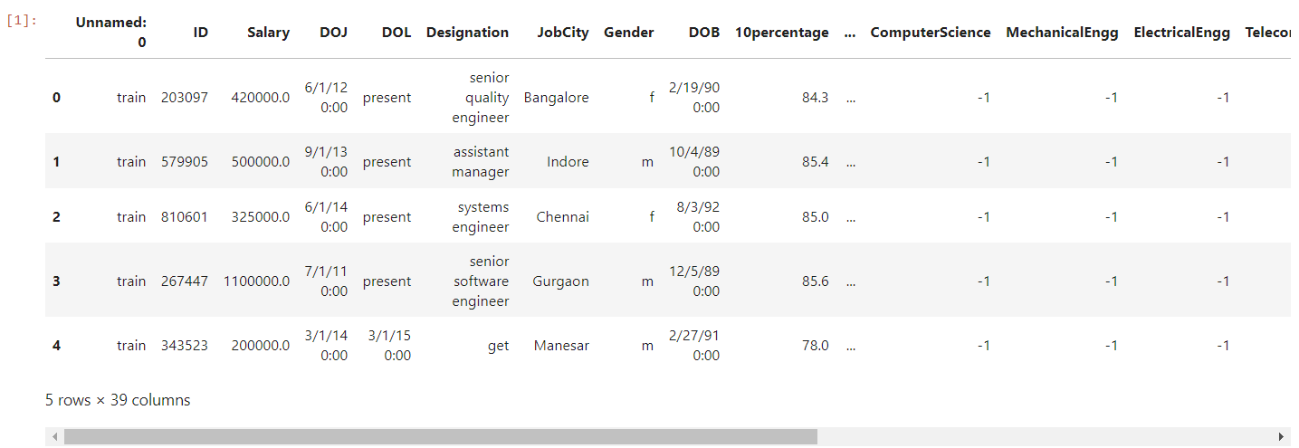
Dataset Overview :
Import Necessary Libraries: pandas, numpy, matplotlib.pyplot, seaborn, scipy
Set up Visual Aesthetics: Used seaborn function to set the overall appearance of the plots in a style with white background and a grid.
Load and display the head of dataset : Used pd.read_csv() and df.head() functions.

Slide 7
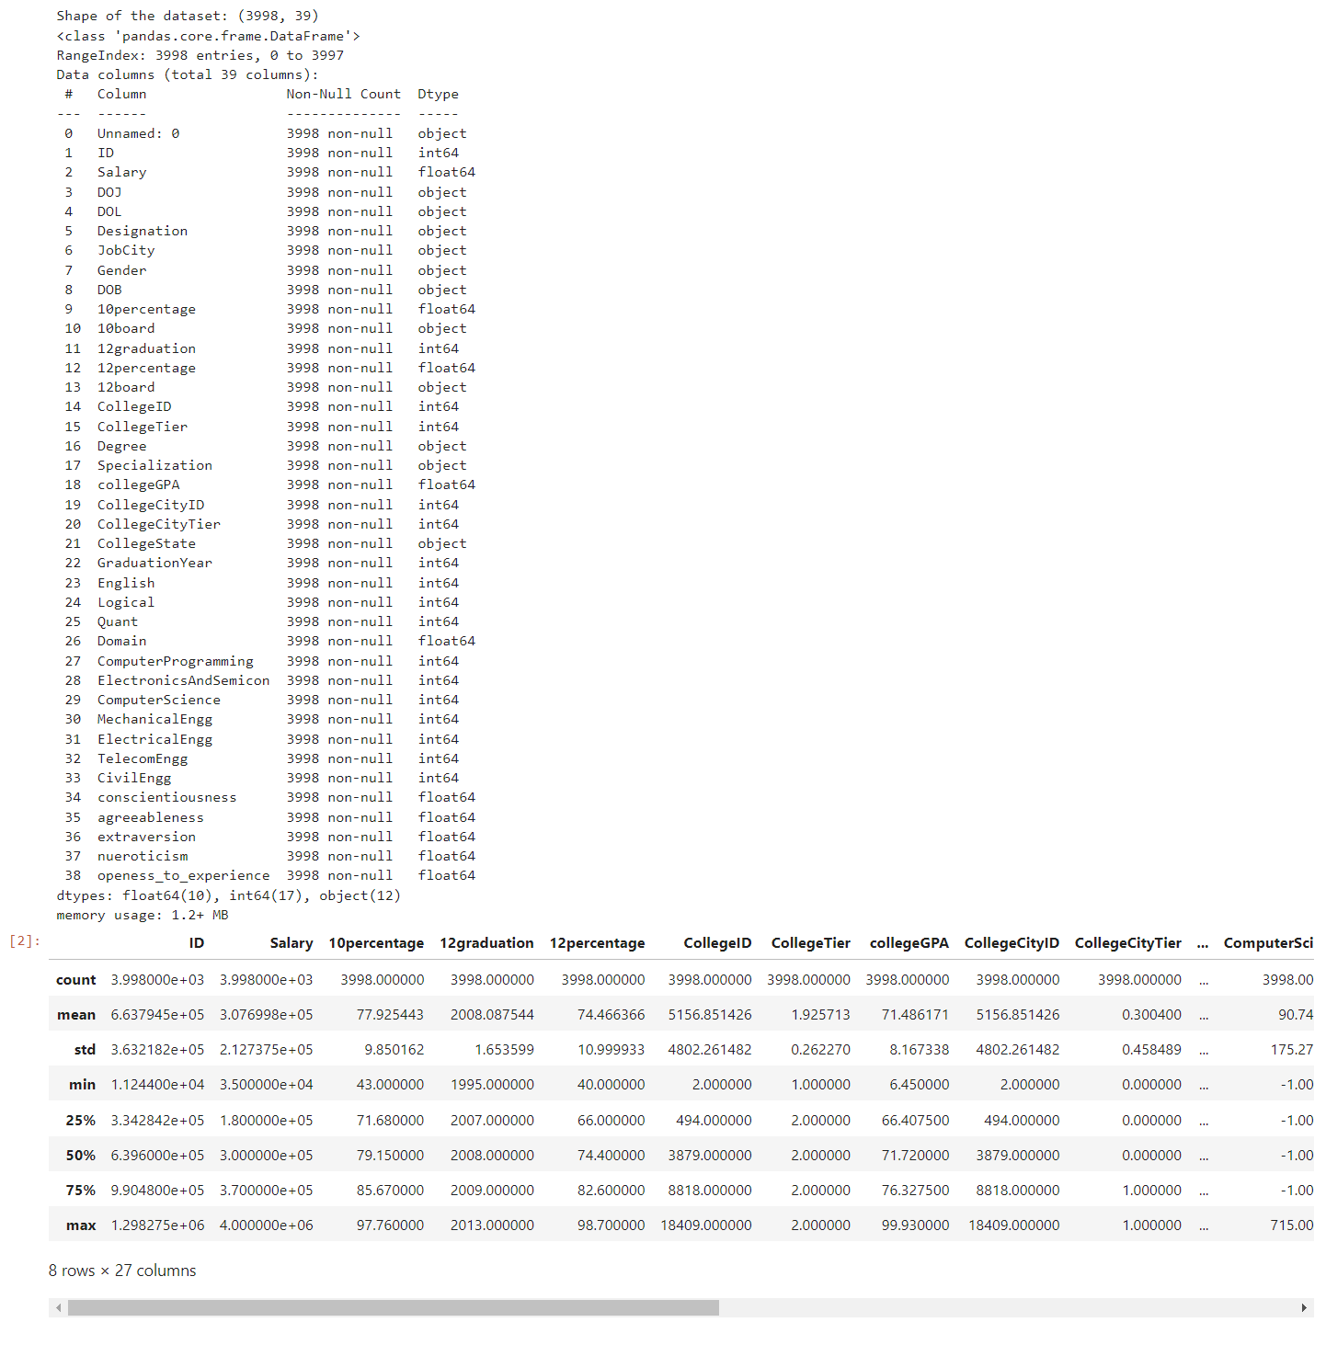
Display the Shape of dataset: Used df.Shape function.
Summary of the dataset: Used df.info() function.
Description of the dataset: Used df.describe() function. The dataset contains 3999 rows and 39 columns.

Slide 8
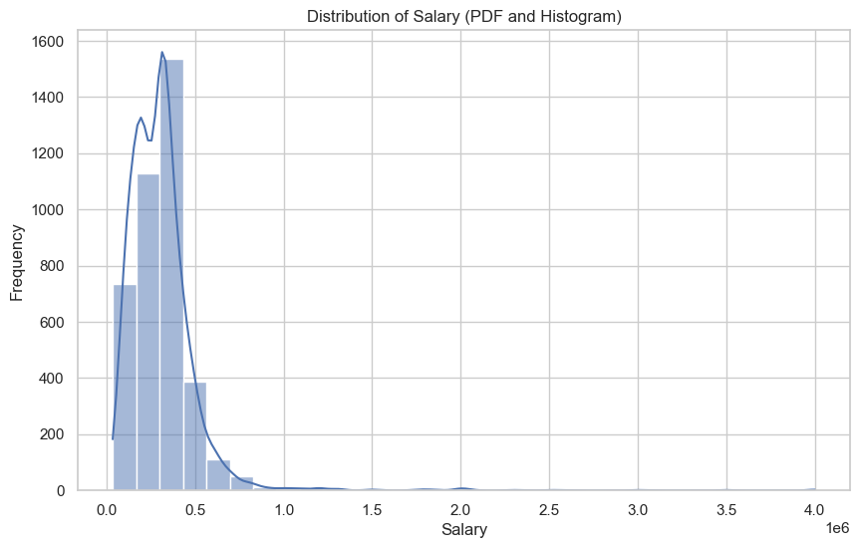
Univariate Analysis :
The distribution has a long tail to the right, indicating that most salaries are concentrated on the lower end, while a few extreme values exist on the higher end.
The majority of the salaries fall below 500,000 (0.5 million) as shown by the high frequency bars in that range.
There are some data points extending beyond 1 million, but their frequency is very low, indicating they might be outliers or extreme cases.
The highest frequency occurs around the range between 100,000 and 300,000, suggesting that the most common salaries lie in that range.

Slide 9
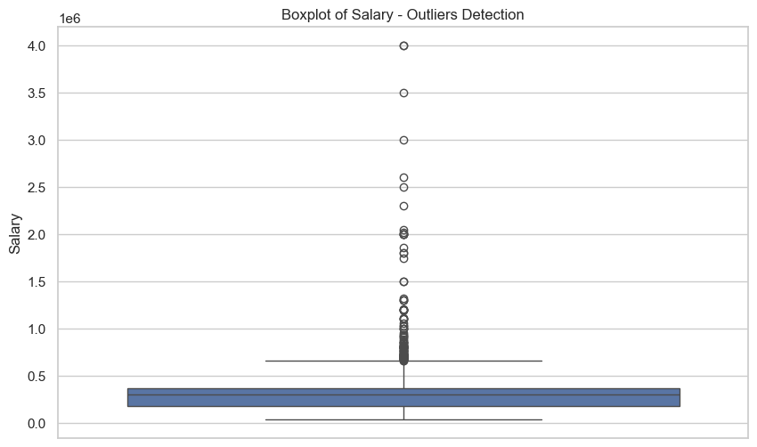
The distribution is right-skewed, with a large number of outliers on the higher end of the salary spectrum.
There are numerous outliers, especially beyond the 1 million mark, extending up to 4 million. These values are significantly higher than the rest of the data.
The blue box represents the middle 50% of the data (from the 1st quartile to the 3rd quartile). This range appears to be quite compressed, showing that most salaries are clustered in a narrow range.
The whiskers extend up to a certain point before the outliers start, indicating that typical salaries (excluding outliers) are below 500,000.
The line within the box represents the median salary, which is below 300,000, indicating that half of the salaries are lower than this value.

Slide 10
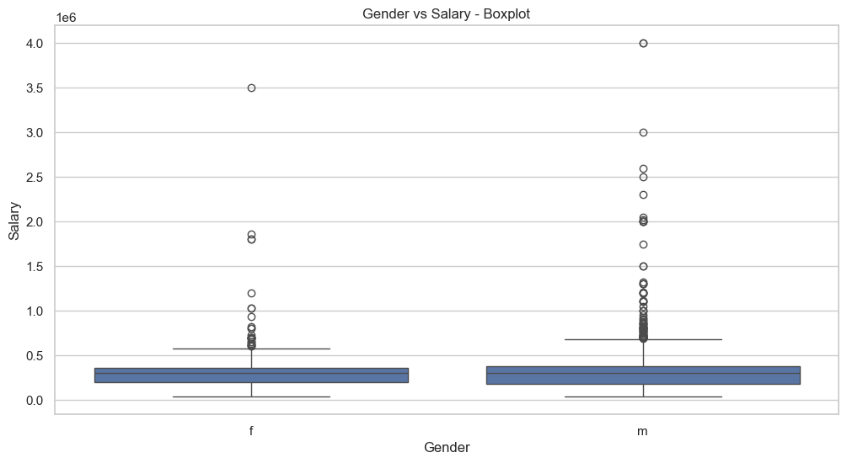
Bivariate Analysis :
Both males and females have a similar median salary, as indicated by the height of the blue boxes.
The IQR (range between the first and third quartiles) seems nearly identical for both genders, indicating similar central distributions of salaries.
There are several outliers in both groups, but more prominent in the male category, with salaries reaching much higher than in the female group. The male group has outliers that reach as high as 4 million, while the highest outlier in the female group is around 3.5 million.
The overall salary spread, including outliers, is wider for males than females.

Slide 11
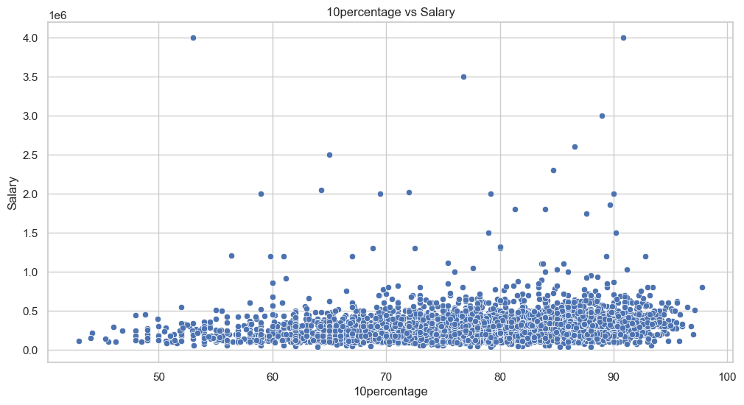
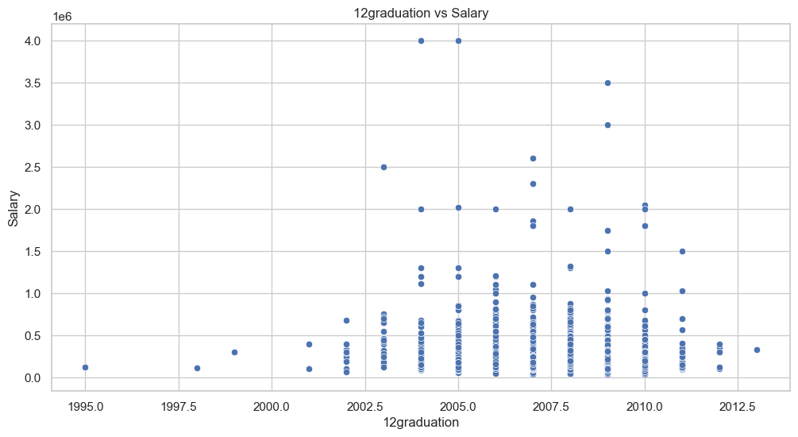
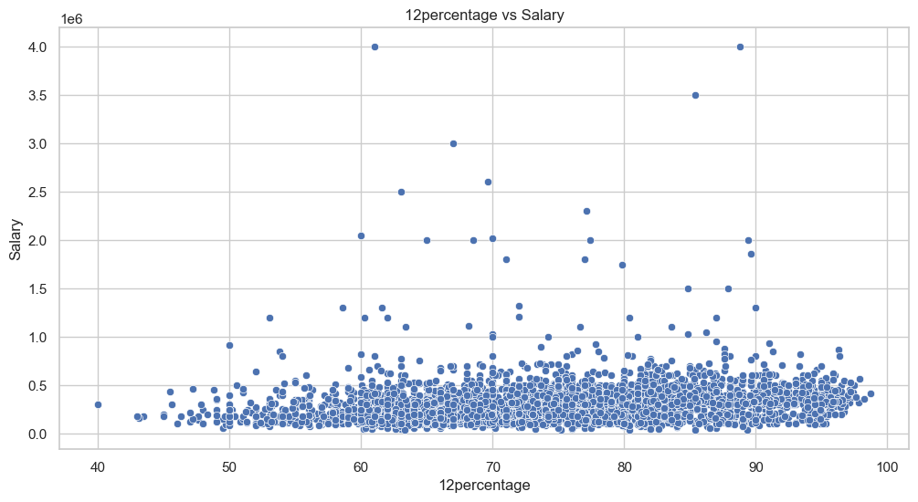
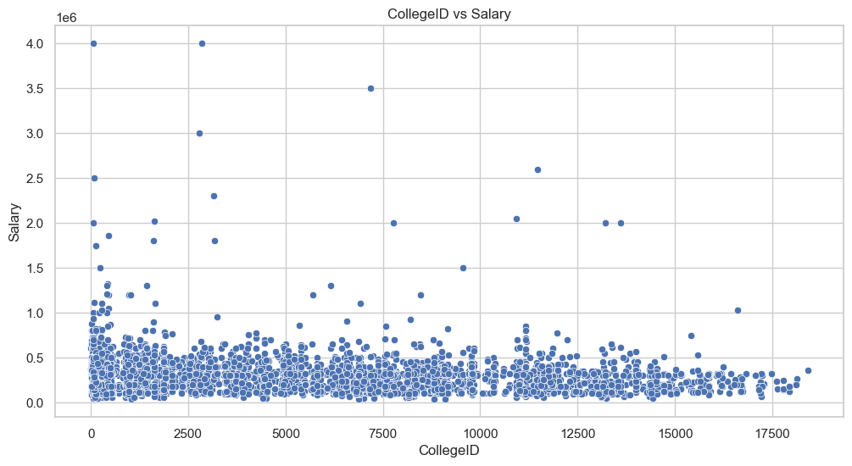
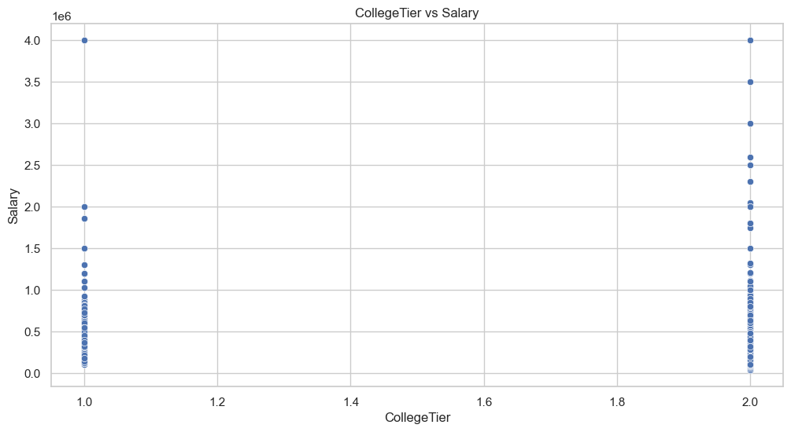
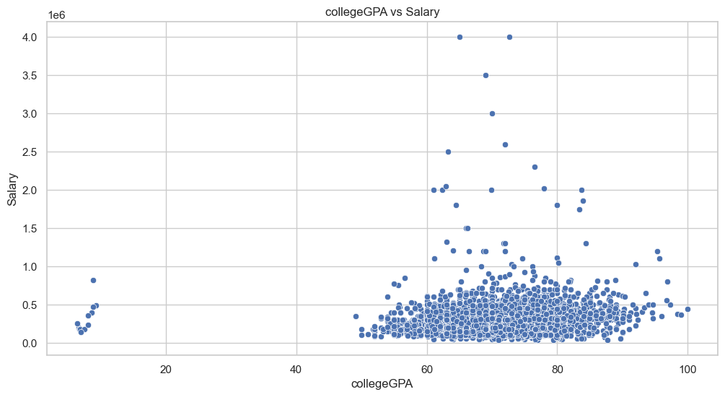

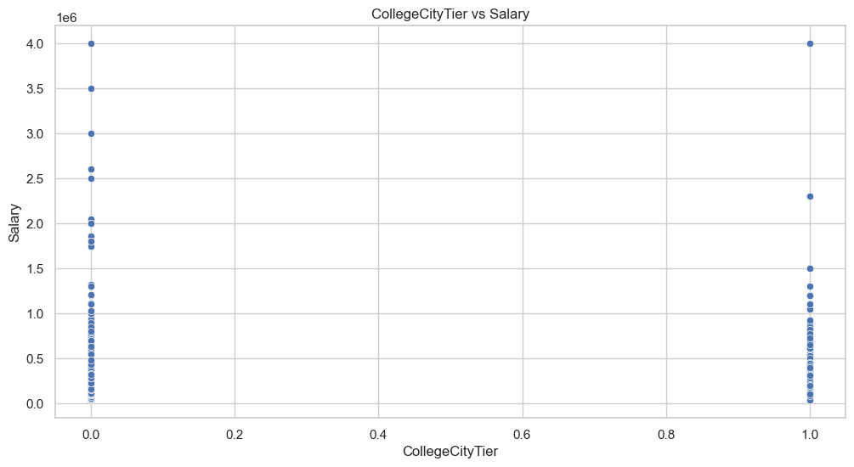
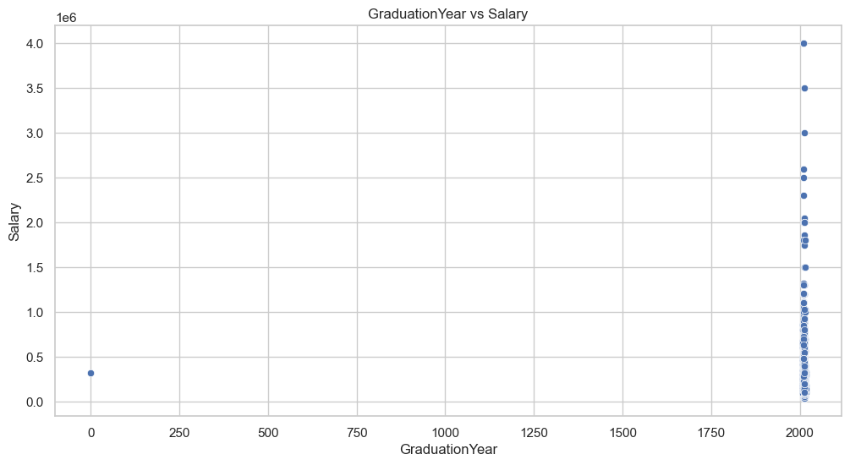
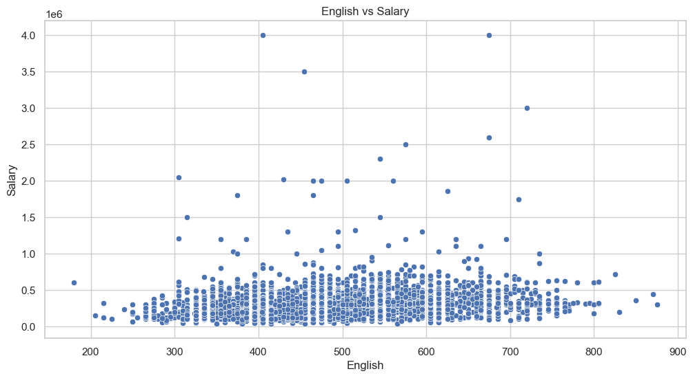
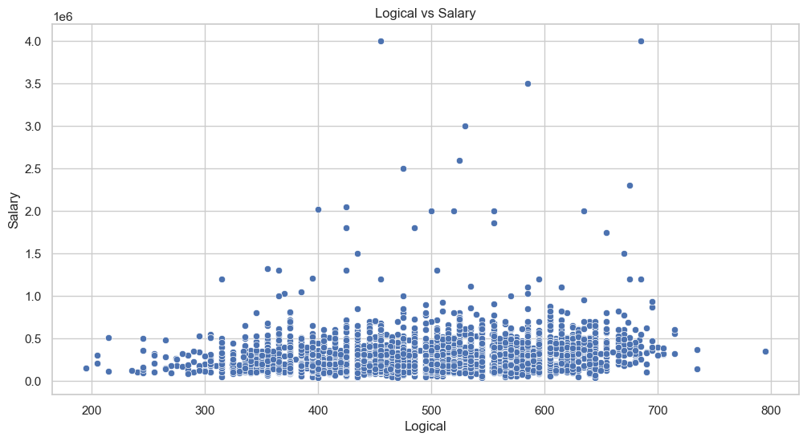
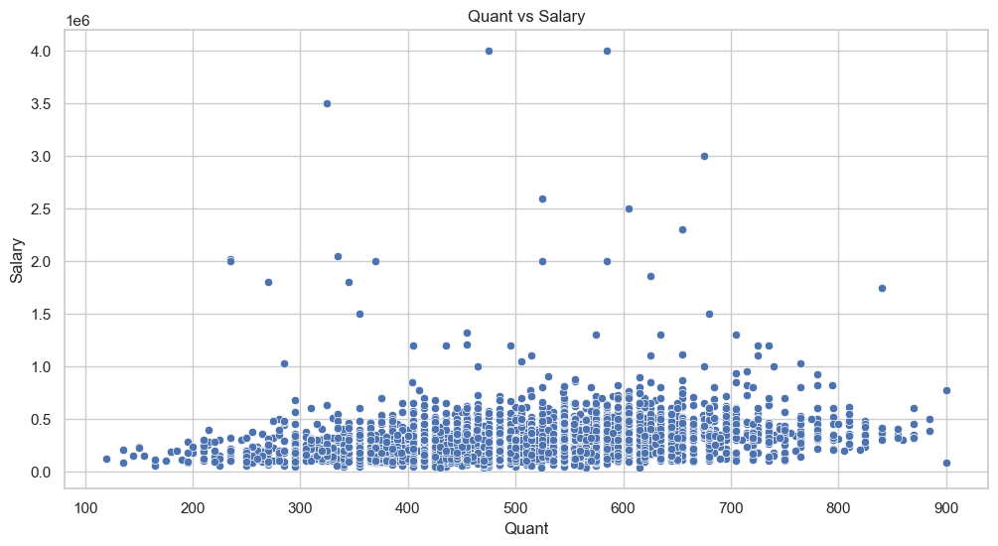
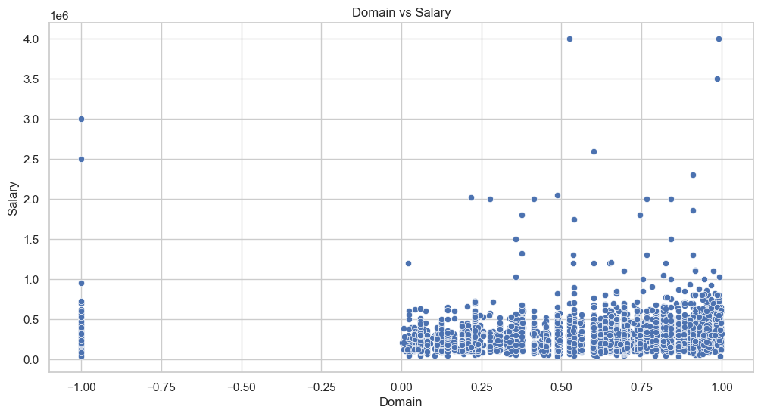
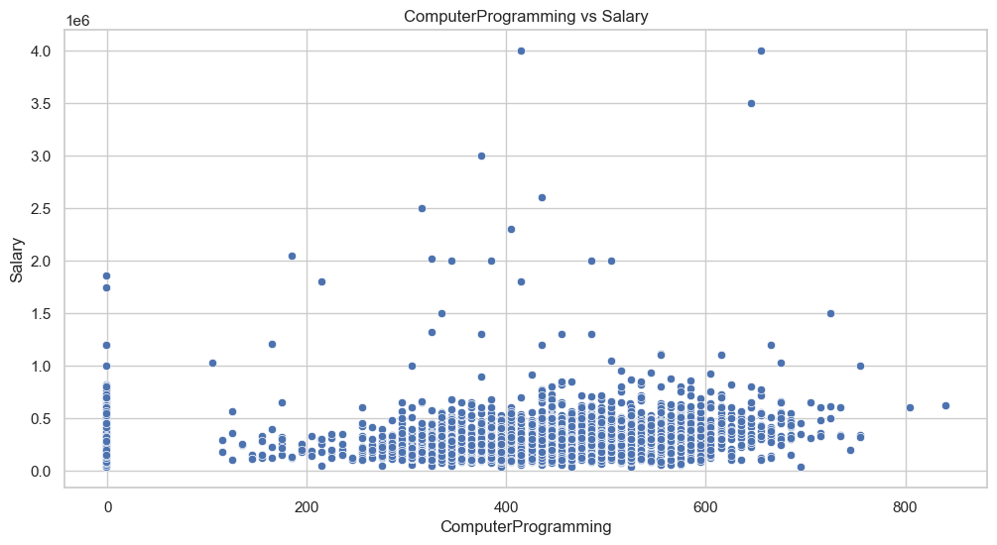
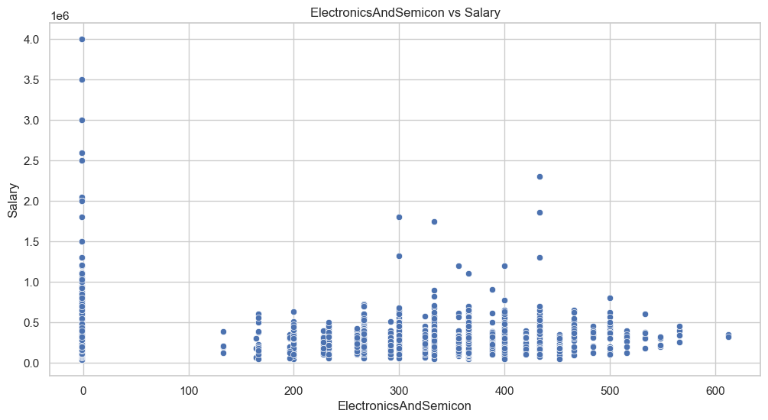

Slide 12
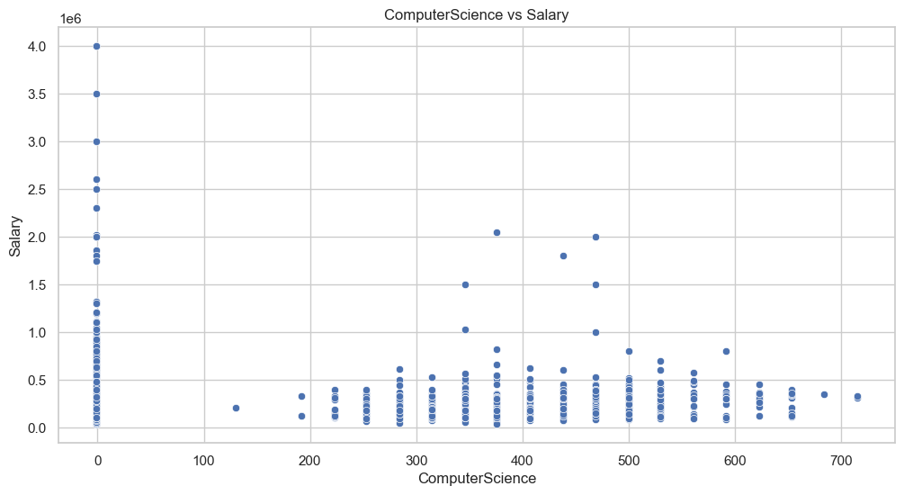
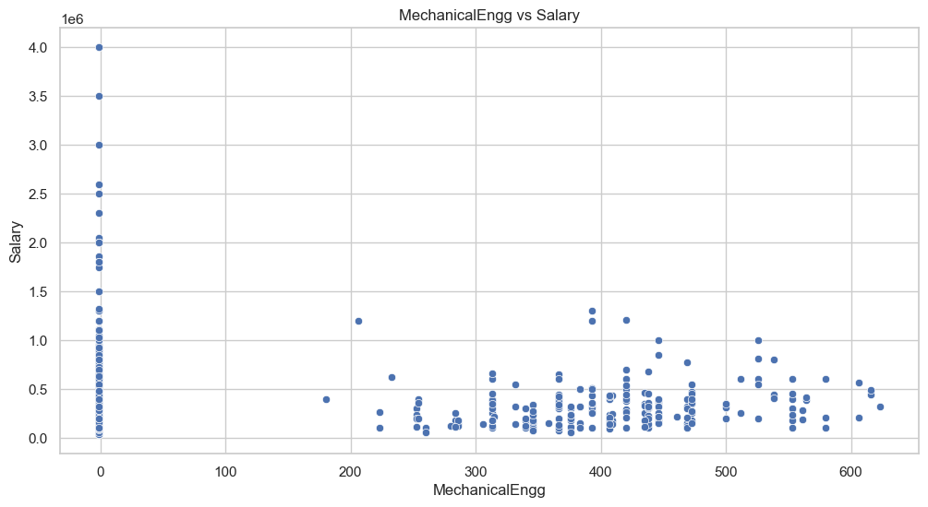
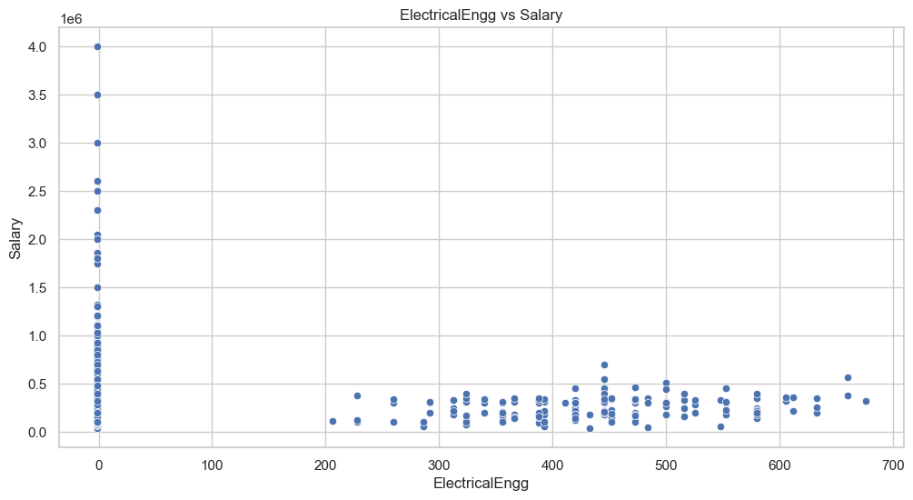
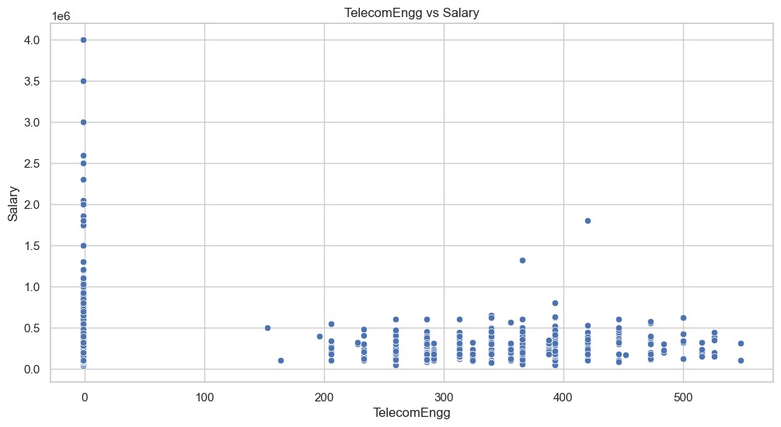
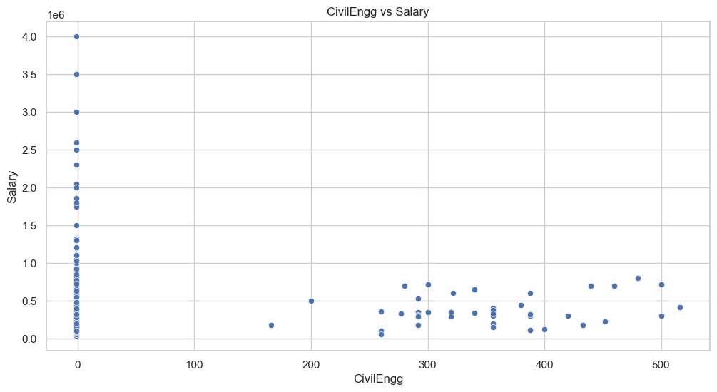
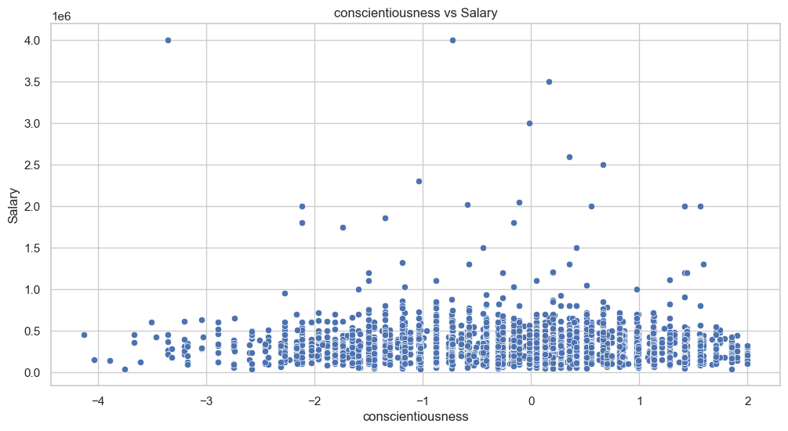
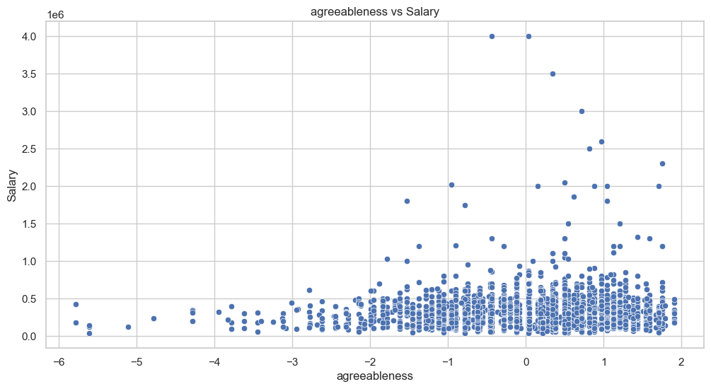
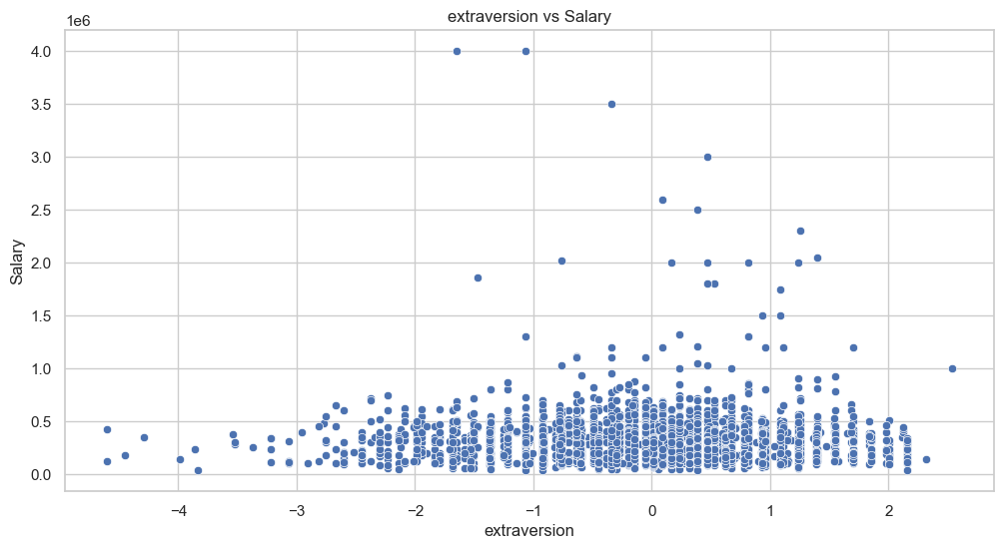
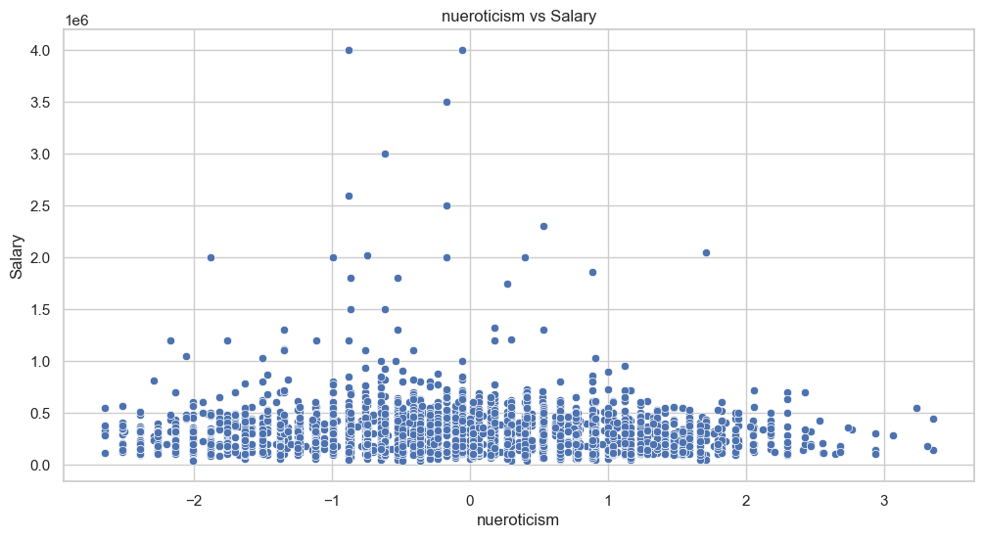
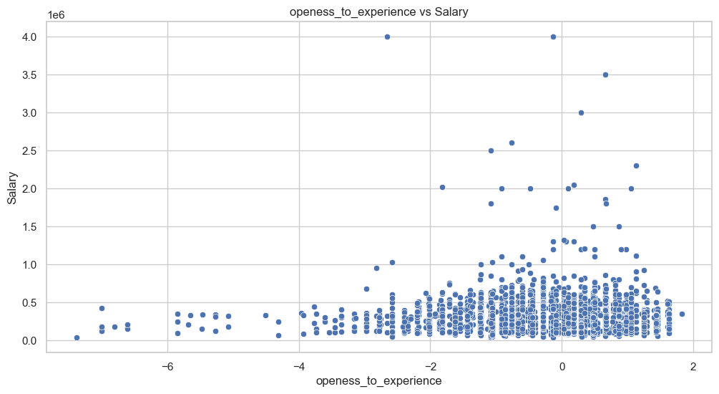
A significant portion of salaries appears to be under 1 million, suggesting a concentrated range of salaries for most IDs.
Several outliers with much higher salaries, reaching up to 4 million. These outliers are spread randomly and do not follow any clear pattern relative to the IDs.
Most data points show that salaries cluster around lower values, but there are a few extreme salaries that are significantly higher.

Slide 13
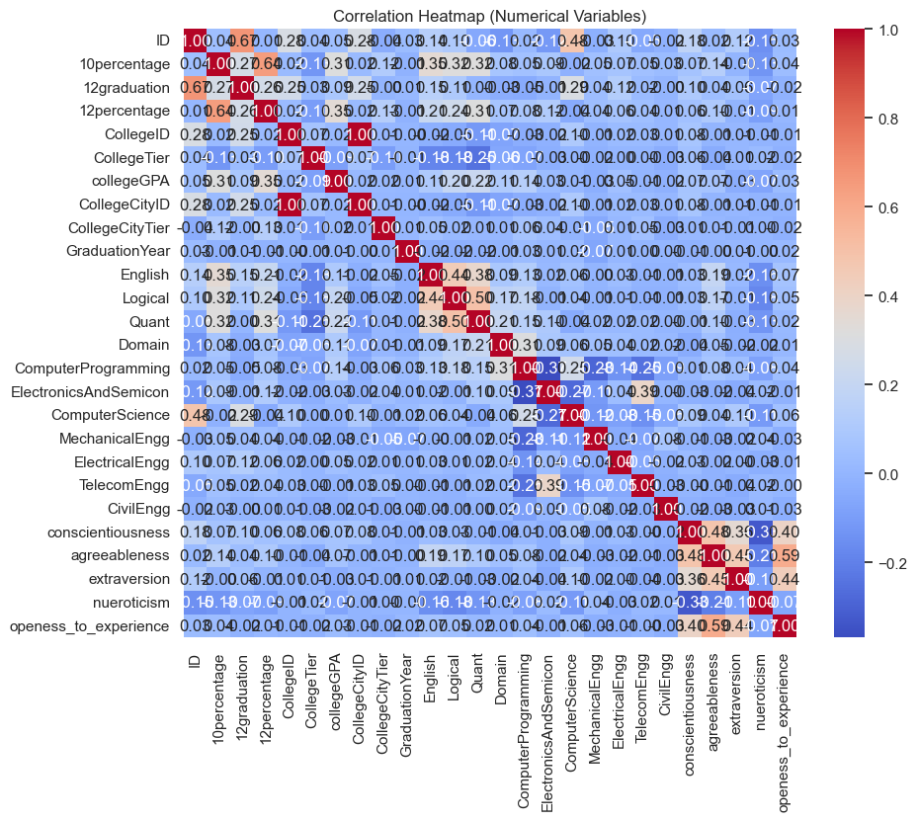
The diagonal shows perfect correlation (value = 1) between each variable and itself, highlighted in dark red.
Positive correlations are visible between 10percentage, 12percentage, 10graduation, ComputerProgramming, ComputerScience, conscientiousness and openness_to_experience.
Many variables, such as TelecomEngg, MechanicalEngg, and personality traits like agreeableness and extraversion, have near-zero correlations with other academic variables like GPA or graduation year.
Neuroticism and traits like extraversion,have negative correlations.
Darker red signifies stronger positive correlations, while dark blue signifies stronger negative correlations. Lighter colors (whites and light blues) indicate weaker or no correlations between the variables.

Slide 14
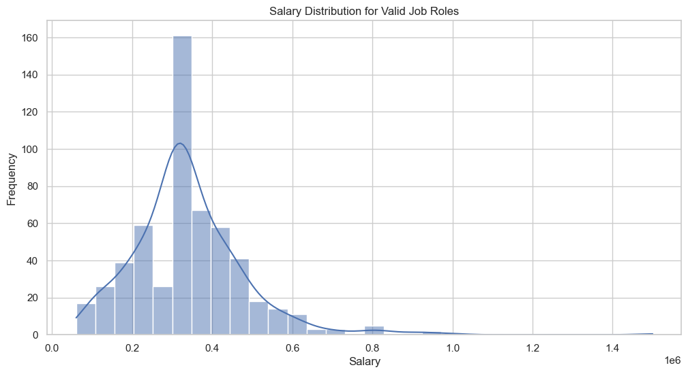
Research Questions :
The highest frequency of salaries appears to be between ₹2 lakhs and ₹4 lakhs, as indicated by the tall bar in that range. This aligns with the claim that fresh graduates can earn salaries in the range of ₹2.5-3 lakhs.
The salary distribution shows a right-skewed pattern, meaning most of the salaries are clustered in the lower range (below ₹6-7 lakhs), while only a few higher salaries go beyond that.
The article states that fresh graduates can earn up to ₹3 lakhs. The peak of the distribution (around ₹2-4 lakhs) supports this, as most salaries for the job roles fall within or near the specified range.
There are very few outliers beyond ₹8 lakhs, suggesting that a smaller number of job roles offer significantly higher salaries, which likely doesn’t apply to most fresh graduates.

Slide 15
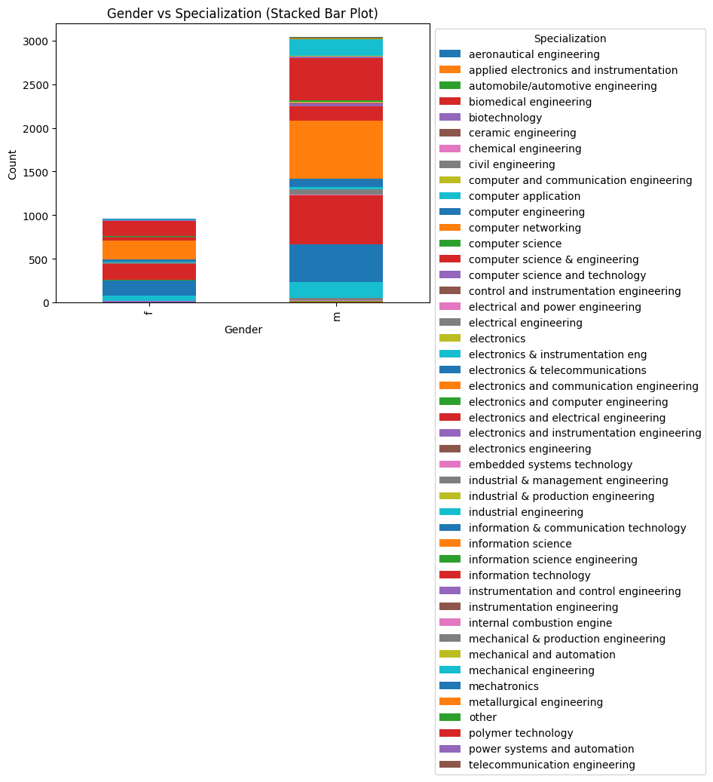
The bar for male students (assuming the larger one is for males) seems significantly larger for specializations such as mechanical engineering, civil engineering and electronics-related branches.
There is a smaller proportion of female students across many specializations, but computer science and information technology might show relatively more female representation.
Some specializations have both genders present, but the size of their segments varies. This indicates gender preference differences in certain fields.
The preference for specialization does appear to depend on gender, as males tend to dominate certain traditional engineering fields, while females have a larger share in fields like computer science and information technology.

Slide 16
Conclusion :
After performing an extensive Exploratory Data Analysis (EDA) on the dataset, including univariate, bivariate analyses, and answering research questions, here are the key findings and conclusions:
Univariate Analysis : Salary and other numerical variables like Age and Years of Experience exhibit skewed distributions, with outliers present in some cases.Gender and other categorical variables show imbalanced distributions, with certain specializations being more prevalent in specific gender groups.
Bivariate Analysis : Salary varies significantly by Designation, with roles like Software Engineer and Hardware Engineer earning higher salaries.Gender influences Specialization choices, with males dominating fields like Software Engineering, and females leaning more toward CSE and IT roles.
Research Questions : The salary claim that fresh graduates can earn 2.5-3 lakhs in specific roles (e.g., Software Engineer) is supported by the dataset. There is a clear relationship between Gender and Specialization, with men favoring technical roles and women gravitating toward IT or CSE.
Key Takeaways :
Salaries tend to be skewed, with many individuals earning lower salaries, which could suggest the presence of entry-level or less-experienced individuals in the dataset.
There is a noticeable impact of designations on salaries, with more technical and senior roles correlating with higher salaries.
Gender plays a significant role in specialization preferences, with male employees more likely to choose engineering or software roles, while females tend to gravitate towards CSE and IT.

Slide 17

THANK YOU

